Slide 1
DIGITAL PORTFOLIO
NAME :MEGAVARSHINI.S
REGISTER NO :24131210500122023
DEPARTMENT :2nd BCA
COLLEGE :IMMACULATE COLLEGE
FOR WOMEN
NAANMUDHALVA ID:asanm121anm121213023

Slide 2
PROJECT TITLE
STUDENT PORTFOLIO

Slide 3
AGENDA
1.Problem Statement
2.Project Statement
3.End Users
4.Tools and Technolgis
5.Portfolio Design and Layout
6.Features and Functionality
7.Results and Screenshots
8.Conculsion
9.GitHub Link

Slide 4
PROBLEM STATEMENT
Provides background information on the problem,including what is currently known.
Clearly states the specific problem or challenge the project will address.
Explain why this problem is important,its impact on users or stake holders,and the value of finding a solution.

Slide 5
PROJECT OVERVIEW
Project titile: A brief descriptive title.
Project descripition: A concise summary of the project.
Objectives: The goals and objectives of the project.
Skills used: The skills and technologies utilized.

Slide 6
END USERS
Potentil employers: Hiring managers,recruiters or HR professionals.
Clients: Businesses or individuals looking for services.
Industry peers: Coleages,competitors,or partners.

Slide 7
TOOLS AND TECHNOLOGIES
Microsoft office
Google workspace
slack

Slide 8
PORTFOLIO DESIGN AND LAYOUT
Grid-based: Organized structure for showcasing.
Whitespace: Effective use of empty space for clarity.
Respnive desgin: Adapts to different screen sizes and devices.

Slide 9
FUTURES AND FUNCTIONALITY
Project showcase: Diseplaying projets with images,descriptions,and links.
Responsive desgin: Adapating to different screen sizes and devices.
Easy navigation: Intuitive menu and clear categorization.

Slide 10
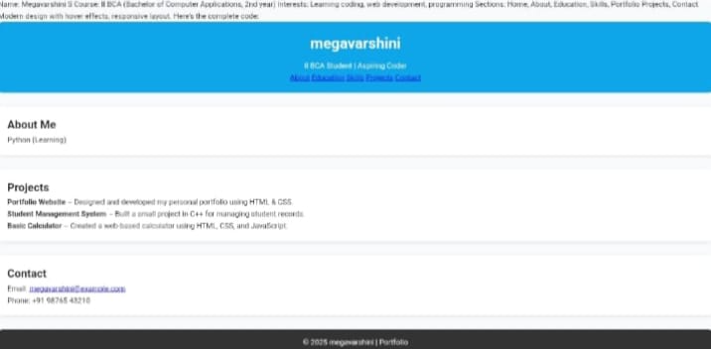
RESULTS AND SCREENSHOTS
Add Screenshots of portfolio project.
Demo Screens.

Slide 11
CONCULSION
A digital portfolio is an essential tool for porfessionals and students,offering a dynamic and interactive way to showcase skills.
However,depends on throughful curation and ongoing engagement.

Slide 12
GITHUB LINK
Direct GitHub link.
https://github.com/megav2607-dot/Megavarshini-TNSDC-FWD-DP.git

